Slide 1
HP ZONE-F Regional Training Centre Welcomes you On Three days Capacity Building Program for IT Teachers Date : 11,12 and 13 April, 2021

Slide 2

GitHub
Why is everyone talking about it?
- Rajesh Verma
MRA DAV Public School, Solan

Slide 3
Why is everyone talking about it?
Immensely powerful community
The largest shared repository
Easy Version Control
A myriad of integration
Secured Cloud Storage

Slide 4


AGENDA
GETTING STARTED WITH GIT & GITHUB
What is GitHub?
What is Version Control?
Why do we need a Version Control System?
Create your own GitHub Account.
Get Started with your first project.
What is a repository?
Creating your first repository
Be a team contributor
Exploring Github

Slide 5


git + Github

Slide 6
git
Git is software for tracking changes in any set of files, usually used for coordinating work among programmers collaboratively developing source code during software development

Slide 7
What is GitHub?
GitHub is a code hosting platform for version control and collaboration. It lets you and others work together on projects from anywhere.

Slide 8

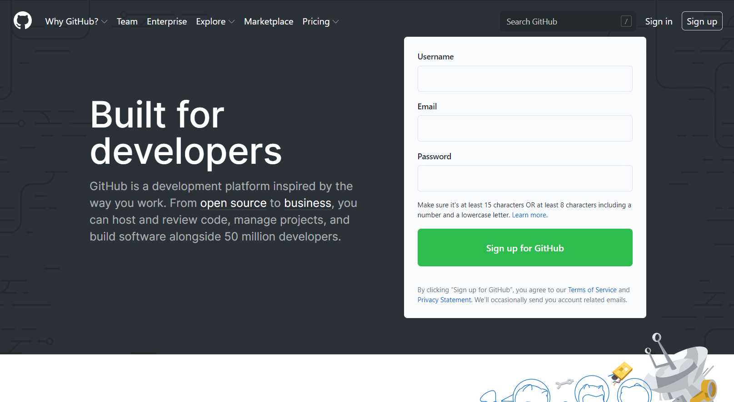
GitHub
https://github.com/
create an account

Slide 9

Collab with others using Github

Slide 10
Create a Repository
A repository is usually used to organize a single project. Repositories can contain folders and files, images, videos, spreadsheets, and data sets – anything your project needs.
Steps to Create a Repository
In the upper right corner, next to your avatar or identicon, click and then select New repository.
Name your repository hello-world.
Write a short description.
Select Initialize this repository with a README.
Click Create repository.

Slide 11
Create a Branch
Branching is the way to work on different versions of a repository at one time.
Steps to Create a Branch
Go to your new repository
Click the drop down at the top of the file list that says branch: main.
Type a branch name, readme-edits, into the new branch text box.
Select the blue Create branch box or hit “Enter” on your keyboard.

Slide 12
Make and commit changes
On GitHub, saved changes are called commits. Each commit has an associated commit message, which is a description explaining why a particular change was made.
Steps to Make and commit changes
Click the file.
Click the pencil icon in the upper right corner of the file view to edit.
In the editor, write a bit about yourself.
Write a commit message that describes your changes.
Click Commit changes button.
.

Slide 13
Make and commit changes
On GitHub, saved changes are called commits. Each commit has an associated commit message, which is a description explaining why a particular change was made.
Steps to Make and commit changes
Click the file.
Click the pencil icon in the upper right corner of the file view to edit.
In the editor, write a bit about yourself.
Write a commit message that describes your changes.
Click Commit changes button.
.

Slide 14
Open a Pull Request
Pull Requests are the heart of collaboration on GitHub. When you open a pull request, you’re proposing your changes and requesting that someone review and pull in your contribution and merge them into their branch. Pull requests show diffs, or differences, of the content from both branches. The changes, additions, and subtractions are shown in green and red.
.

Slide 15
Steps to Open a Pull Request
Click the Pull Request tab, then from the Pull Request page, click the green New pull request button.
In the Example Comparisons box, select the branch you made, readme-edits, to compare with main (the original).In the editor, write a bit about yourself.
Look over your changes in the diffs on the Compare page, make sure they’re what you want to submit.
When you’re satisfied that these are the changes you want to submit, click the big green Create Pull Request button.
Give your pull request a title and write a brief description of your changes.

Slide 16
Merge your Pull Request
Click the green Merge pull request button to merge the changes into main.
Click Confirm merge.
Go ahead and delete the branch, since its changes have been incorporated, with the Delete branch button in the purple box.

Slide 17
Education
GitHub Education helps you teach or learn software development with the tools and support of GitHub's platform and community.
GItHub for Students
Github for Teachers
Github Classroom https://classroom.github.com/
Link to access github for Education https://education.github.com/

Slide 18


